Slide 1
@aimeurope
fb.com/aimeurope
eu.aimint.org
Notes:
Today we will be thinking about our world and our place in it. We will hear about how God has been doing amazing things in Africa and then we will fix our eyes upon Jesus as our perfect example of life.

Slide 2
Africa- a big challenge
While the church is growing rapidly in sub-Saharan Africa, North Africa and the Indian Ocean are almost completely Islamic
An unreached people group is a people, with their own culture, language and tradition that has no indigenous church
There are almost one thousand peoples in Africa with no church and very few Christians
One of the great challenges is to encourage, envision and equip the sub-Saharan church into mission
Notes:
First of all, let’s get an update of how the gospel is progressing in Arica. (go through the points on this slide.)

Slide 3
Show Mwani video
https://eu.aimint.org/the-unreached-the-mwani/
Notes:
(Beforehand download this video from https://eu.aimint.org/the-unreached-the-mwani/)
We are now going to watch a video that graphically demonstrates some of the challenges to people hearing the gospel in Africa. (watch the video)

Slide 4
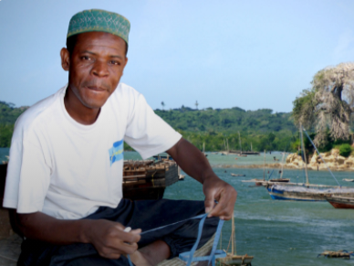
Pray for mercy on the Mwani that they would turn to him!
Notes:
AIM, together with a couple of other mission agencies have been working with the Mwani for over twenty years​
There has been very few Mwanis that have turned to Christ​
Two years ago a militant Islamic group started fighting, destroying villages and towns and killing many people​
Almost all the Mwani have now fled to refugee camps far away from their homes​
Sometimes it feels that there is very little we can do to help! But our Father hears our prayers. Please pray for mercy on the Mwani that they would turn to him!

Slide 5
If you would like to pray regularly for the Mwani and other unreached people groups go to eu.aimint.org/getinvolved/
Notes:
If you would like to make a difference – pray! For more information to help you pray go to eu.aimint.org/get involved/

