Slide 1
@aimeurope
fb.com/aimeurope
eu.aimint.org
Notes:
Notes to accompany these slides can be found in this notes area throughout the presentation.
Please feel free to adapt the slides and information you share to suit your congregation. There is no obligation to use all of the slides or information, or indeed to use the slides at all.

Slide 2
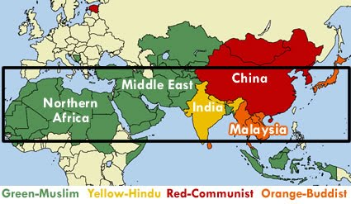
North Africa is part of the 10/40 window 60000 people die here every day never having heard the Gospel
Notes:
10/40 Window
Area between the 10th and 40th parallels— spanning North Africa, the Middle East, and Asia.
Where 95 percent of the world’s unreached peoples live.
The majority of the world’s Hindus, Muslims, and Buddhists live here.
Two out of every three people live in the 10/40 window.
Five out of six unreached people groups are in this region.
Sixty thousand of those who die daily in the 10/40 window have never heard the gospel.

Slide 3
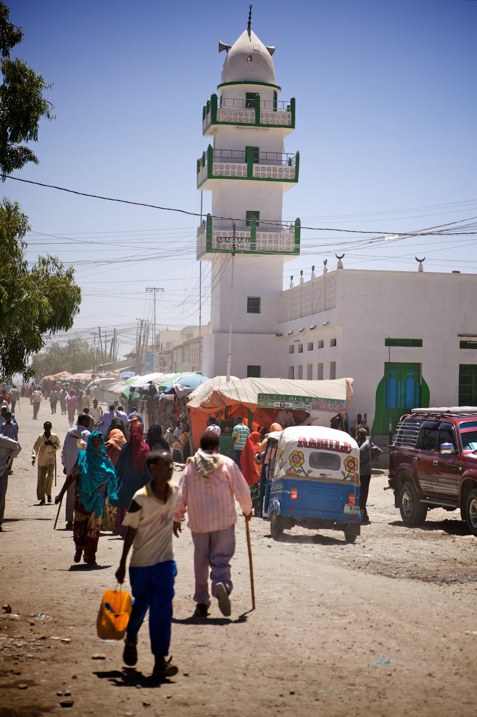
In North Africa alone, 200 million people from 472 people groups are unreached with the gospel.
Notes:
North Africa
18 countries with a total population of over 362 million people.

Slide 4
Less than 1% of people in North Africa are Evangelical Christians
“…how can they believe in the one of whom they have not heard? And how can they hear without someone preaching to them?”
Romans 10:14
Notes:
Only 0.05% of this total are evangelical believers, 90% are Muslim, 200 million form 472 unreached people groups.

Slide 5
In many places Christian evangelism is illegal. For security missionaries’ identities and locations can’t be revealed. But they desperately need your prayers.
Notes:
Many of these countries have an ancient Christian history. However, through decadence, politics, war and Islamic conquest though, this has been all but extinguished. Today, they are buried deep in darkness, desperately in need of the light.
In many places Christian evangelism is illegal

Slide 6
Myriam’s Story…
“…the more I read the Qur’an, the more I found it wanting, and the Bible giving me answers. I was so sad. Realising the Qur’an wasn’t the truth, and that I couldn’t follow Islam was like having to take off my own skin.”
Notes:
Myriam* shares her story about discovering Christianity, and her search for the truth.
Read the full story - https://eu.aimint.org/faith-in-the-balance/

Slide 7
Church in North Africa often means three people meeting to discuss God’s word
“For where two or three gather in my name, there am I with them.”
Matthew 18:20
Notes:
Church in North Africa often means three people meeting to discuss God’s word. Internationals may be permitted to attend churches, but local people are not and will face persecution and ostracism if they do.
There may be no local church in a city of two million. One worker speaks of how for a brief period, a handful of local believers began to meet together for the first time. All but one were baptised. They broke bread together and read the Word constantly, seeing their own lives mirrored in the lives of the early church. They prayed with love and passionate hope to be joined by more. Difficult times have come and they can no longer meet together, but they continue to pray for each other. They are telling others the good news and several more have come to Jesus, but some have left the country and many are afraid to meet.
Where they can, groups meet together in local homes, led by local believers, reading Scripture in the local language, praying together, breaking bread, baptising one another, and writing and singing songs in their own dialect. We pray for husbands and wives to believe, so that their homes can be places that singles can meet appropriately.
The three biggest challenges that we face when it comes to church planting here are unbelief, fear and people leaving the country. So many people hear and reject the grace of Jesus. Those who do believe have been threatened, tortured, imprisoned, even killed. Some have suffered well, others have lied about what they believe to stay alive; all face fear. These believers’ families are threatened and some are forbidden from meeting with other believers. Sometimes it is family who betrays. Some have fled. Some are afraid for their children to tell grandparents. It is difficult for the church to grow if believers are silenced by fear. When there is persecution, some people choose to leave. When people don’t get paid for jobs and there are increased kidnappings and militias fighting, people leave. It is difficult for the church to grow when people leave.
Pray for wisdom, and for boldness for new believers. We believe that God will show how, when and where to gather when the time comes. God will build his church!

Slide 8
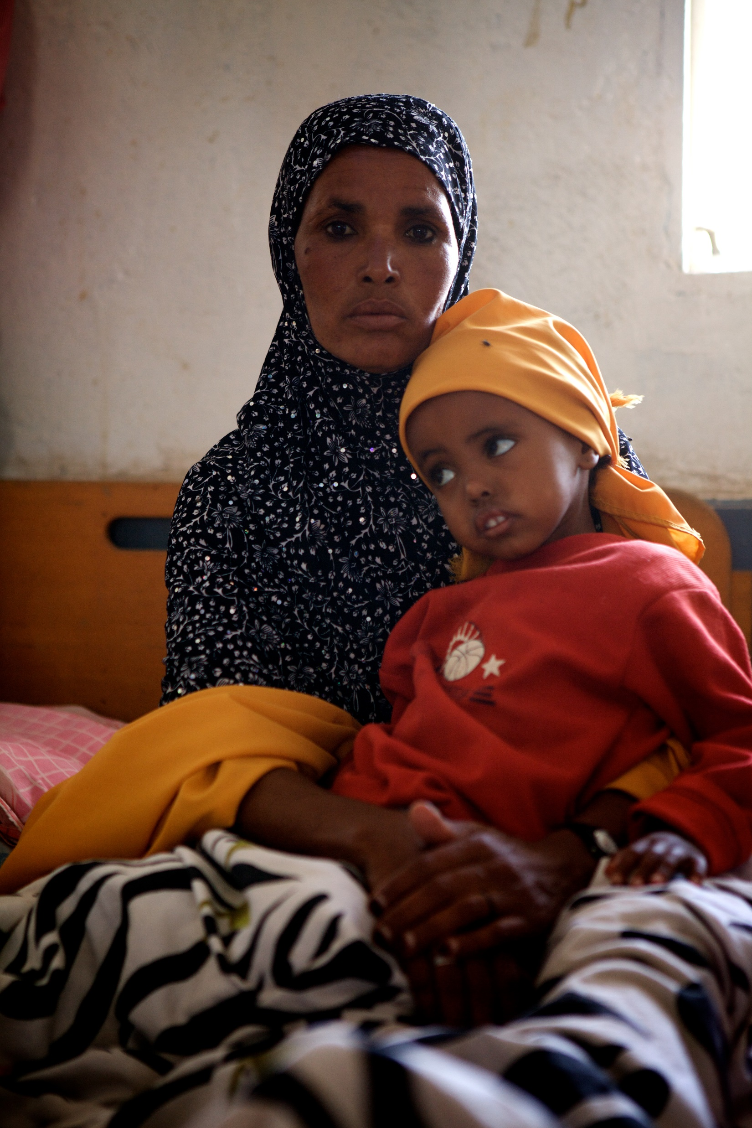
AIM in North Africa
“We trust that where the gospel of Jesus Christ is proclaimed, both in word and deed, the result will be disciple making and church planting movements”
Notes:
AIM’s vision is to bring the life-giving light of Jesus to these unreached people. We are praying for opportunities to share the gospel and see populations of evangelical believers across this region.
To accomplish this vision we will find creative ways that enable followers of Jesus to live amongst these hard to reach peoples. We trust that where the gospel of Jesus Christ is proclaimed, both in word and deed, the result will be disciple making and church planting movements, by mission partners and by Africans.
So what is our strategy?
First is prayer!
Secondly, we are researching every unreached people group across the Northern Region then, based on that information we will seek to place teams where the Lord opens doors for us to work.
Thirdly, we will focus on caring for our personnel by providing clear vision, strategy and support, under good leadership.
Fourthly, we are seeking to partner with like-minded organisations across North Africa as well as engaging with the incredible resources of the African church, so more can participate in reaching the unreached in Africa with the light of Jesus.

Slide 9
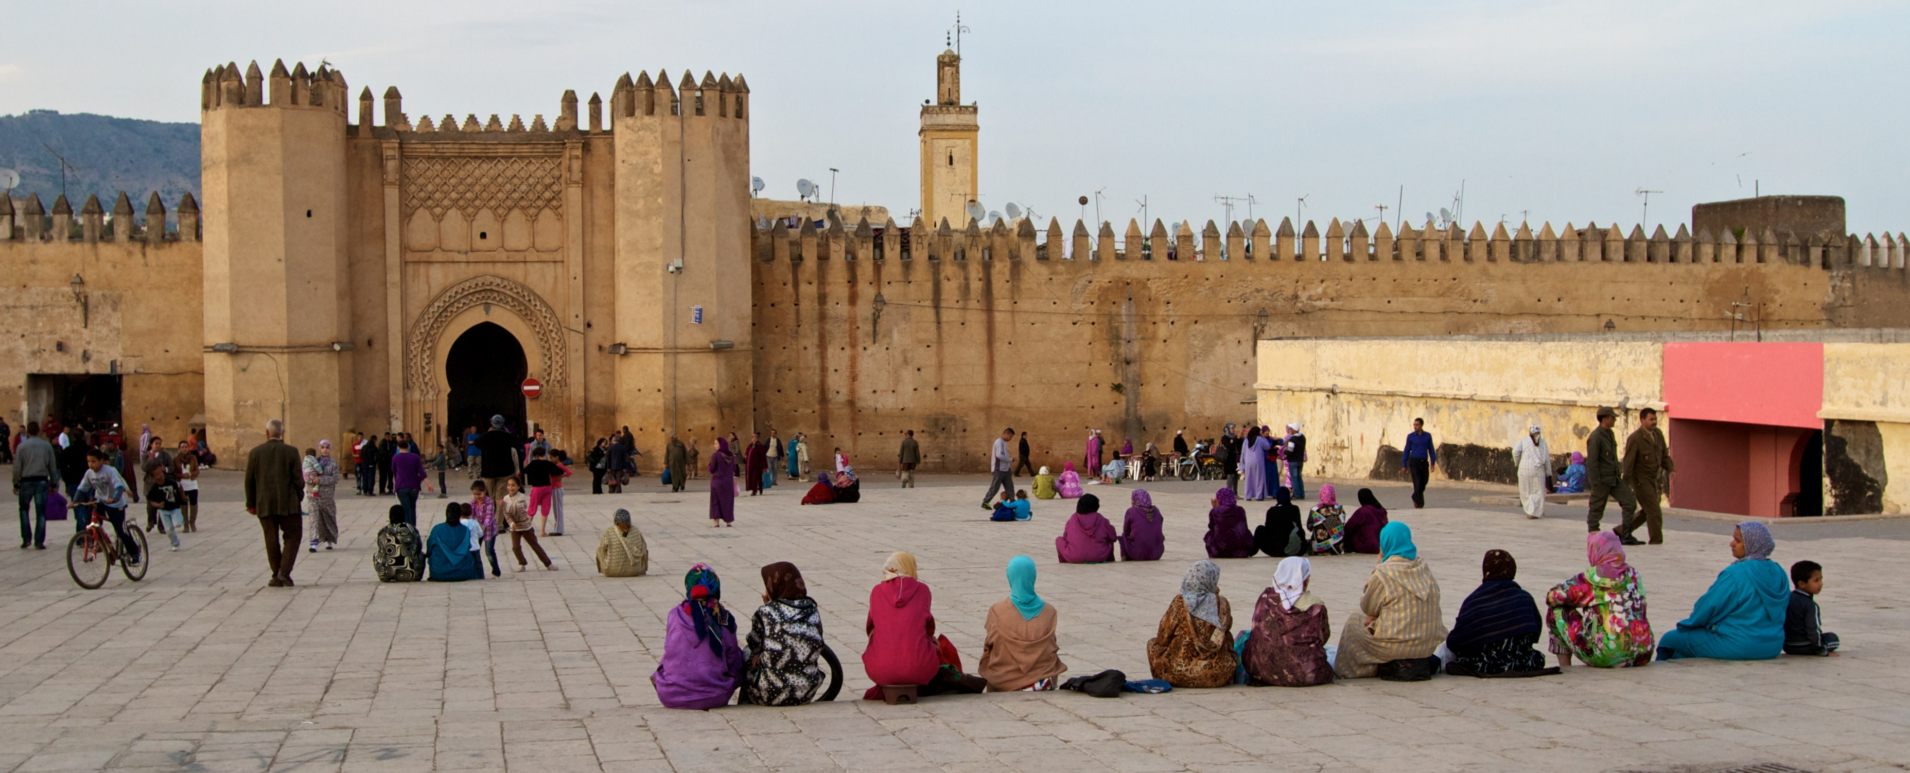
Counting the cost
We are praying for workers who are passionate for Christ and his honour, who are ready to rise to these challenges by the power of the Spirit and who are hungry for the millions who are blind to come to sight through faith in Jesus.
Notes:
The cost will undoubtedly be high. Jesus reminds us that though he will never leave us or forsake us, obedience to him requires sacrifice and suffering. We are praying for workers who are passionate for Christ and his honour, who are ready to rise to these challenges by the power of the Spirit and who are hungry for the millions who are blind to come to sight through faith in Jesus.

Slide 10
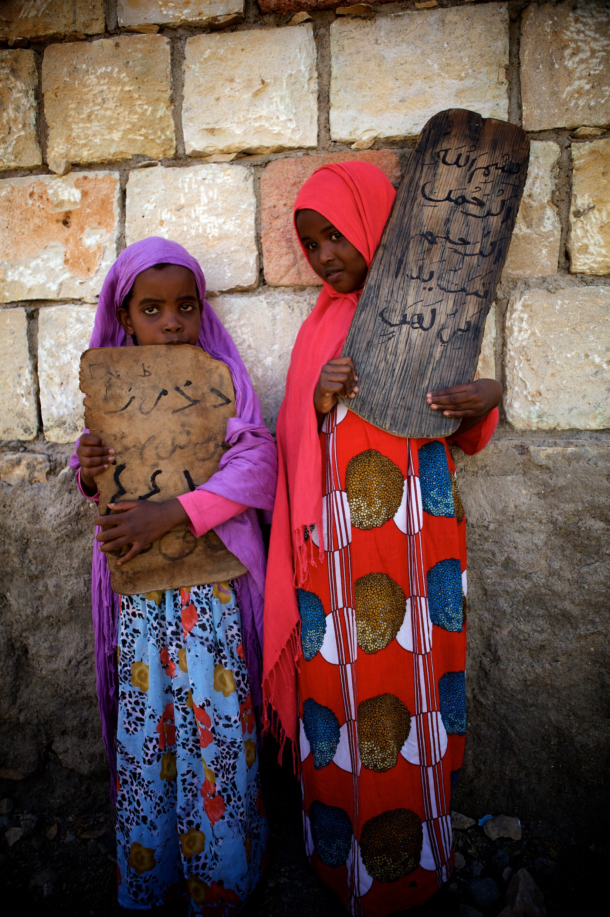
Why bother?
“There are areas in my country that have never had the opportunity to hear the name of Jesus in their own language. This is why we come. God has called us to be light in this dark world.”
Notes:
Quote taken from this article (https://eu.aimint.org/why-north-Africa) asking the question “why bother?” to a medical worker in a North Africa.

Slide 11
Find out more about mission, prayer and how you can serve the people of North Africa in Connect. Sign up online at eu.aimint.org/connect
Notes:
Call to action - Connect
Suggest ways to respond, people may wish to sign up for a magazine to hear more about the work of AIM and how to pray, give or go. You can also invite people to speak to church leadership about their sense of calling, or to attend upcoming events such as mission prayer meetings or conferences etc.

